Slide 1

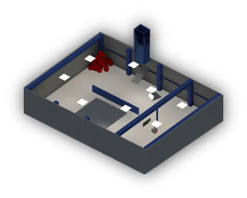
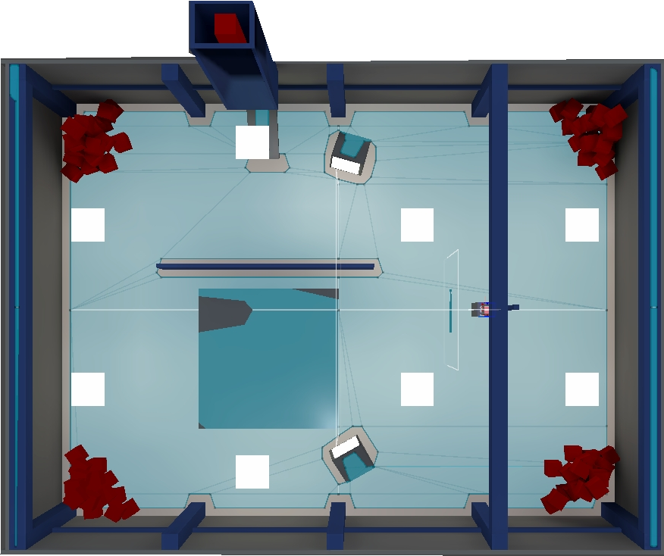
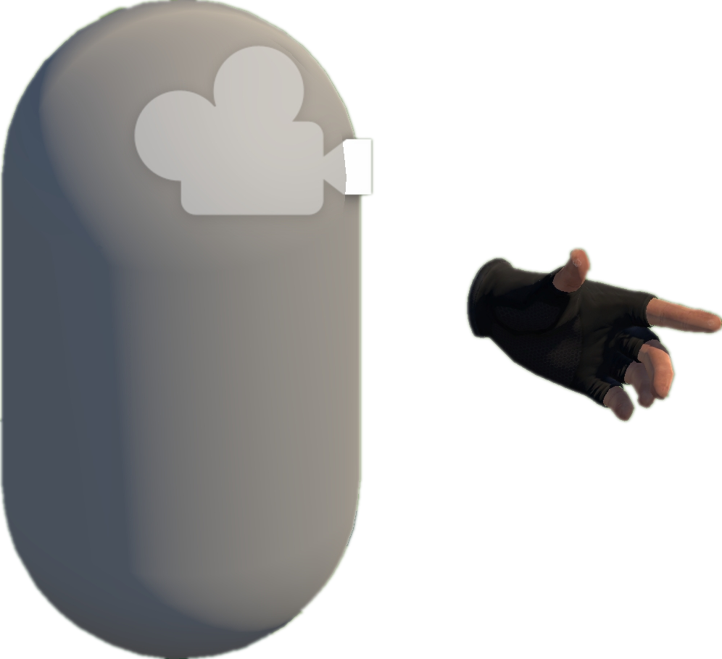








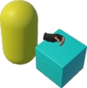
Project Collection
VRExplorer Test
Preliminary Scene Configuration
3
Exploration and Interaction
Open Source
Repositories
1
Camera
Tags & Topics
Hand Controller
Unity-based
Projects
Bake NavMesh
Collider
Quality Unity
VR Projects
Manifest Validation
& Manual Check
Original Scene
VRExplorer
Scene with NavMesh
Scene Analysis & Interaction
Implementation Interface
2
Entity Manager
Plugins/Tools/.dll
Customizing Entity Interface Configuration
List<BaseEntity > e;
List<Mono > m;
Core C# Scripts
Mono Scripts Implemented Entity Interface
Input the Next Interactable Object’s Mono
Execute Task Asynchronously
Original Code
Task Generator
List<BaseAction> GetTask(BaseEntity [] e);
List<BaseAction> GetTask(Mono m);
EAT Framework
Output Current Task in the form of List<BaseAction>
Model Abstraction
Pre-defined & Customized Task Model
Grab-And-Drag-Box Task
Move to Approcach
Parallel Action
Hierarchy Analysis
Game Logic Code & Third Plugin Analysis
Parallel and serial combinations
Grab
Move Action
Grab Action
Environment
Move Action
Interactables
Base Action
Walk Around
Asynchronous Action
Box
Inherit
Abstraction
Grab Action
Trigger Action
Grab
Base Entity
Trigger
EAT Framework
C# Scripts File
Inherit
Task Layer
Entity Interface
Grabbable Entity
Triggerable Entity
Action Layer
GameObjects
Abstraction Object Interaction Feature
Implement
Entity Layer
Unity Scene
Triggerable
Button, Joystick
XR Box
XR Joystick
XR Button
Mono Layer
Third Plugin / .dll / Third Assembly
Grabbable
Gun, Cigarette Lighter
Box, Coin
Notes:
单击此处添加文本

